Slide 1
CPU Scheduling
Basic Concepts
Scheduling Criteria
Scheduling Algorithms
  Various scheduling policies:
    First come, first serve(FCFS)
    Shortest Job First(SJF)
    Priority based
    Round Robin(RR)

Slide 2

Basic Concepts
Maximum CPU utilization obtained with multiprogramming
CPU–I/O Burst Cycle – Process execution consists of a cycle of CPU execution and I/O wait
CPU burst followed by I/O burst
CPU burst distribution is of main concern

Slide 3
CPU Scheduler
Short-term scheduler selects from among the processes in ready queue, and allocates the CPU to one of them
CPU scheduling decisions may take place when a process:
  1. Switches from running to waiting state
    2. Switches from running to ready state
    3. Switches from waiting to ready
  Terminates
Scheduling under 1 and 4 is nonpreemptive--once CPU is allocated to a process, the process keeps the CPU until it releases the CPU, either by terminating or by switching to the waiting state
All other scheduling is preemptive

Slide 4
Preemptive
Preemptive-
preemption is the norm
Preemptive scheduling incurs a cost associated with access to shared data
  Need mechanisms to coordinate access to shared data
  Consider access to shared data
  Consider preemption while in kernel mode
  Consider interrupts occurring during crucial OS activities

Slide 5
Dispatcher
Dispatcher module gives control of the CPU to the process selected by the short-term scheduler; this involves:
    switching context
    switching to user mode
    jumping to the proper location in the user program to restart that program
Dispatch latency – time it takes for the dispatcher to stop one process and start another running

Slide 6
Scheduling Criteria
CPU utilization – keep the CPU as busy as possible
Throughput – # of processes that complete their execution per time unit
Turnaround time – amount of time to execute a particular process
Waiting time – amount of time a process has been waiting in the ready queue
Response time – amount of time it takes from when a request was submitted until the first response is produced, not output (for time-sharing environment)

Slide 7
Scheduling Algorithm Optimization Criteria
Max CPU utilization
Max throughput
Min turnaround time
Min waiting time
Min response time

Slide 8
1. First- Come, First-Served (FCFS) Scheduling

Slide 9
1. First- Come, First-Served (FCFS) Scheduling
Simplest CPU scheduling algorithm
Nonpreemptive algorithm → once the CPU has been allocated to a process, the process keeps the CPU until it releases the CPU
Process that requested the CPU first is allocated the CPU first
Implementation managed by a First In First Out (FIFO) queue
  When a process enters the ready queue its PCB is linked onto the tail of the queue
  When the CPU is free, it is allocated to the process at the head of the queue and the running process is removed from the queue
Average waiting time under FCFS policy is often quite long

Slide 10

1. First- Come, First-Served (FCFS) Scheduling
Process Burst Time
P₁ 24
P₂ 3
P₃ 3
Suppose that the processes arrive in the order: P₁ , P₂ , P₃
The Gantt Chart for the schedule is:
Waiting time for P₁ = 0; P₂ = 24; P₃ = 27
Average waiting time: (0 + 24 + 27)/3 = 17

Slide 11

FCFS Scheduling (Cont.)
Suppose that the processes arrive in the order:
P₂ , P₃ , P₁
The Gantt chart for the schedule is:
Waiting time for P₁ = 6; P₂ = 0; P₃ = 3
Average waiting time: (6 + 0 + 3)/3 = 3
Much better than previous case
Convoy effect - short process behind long process
  Consider one CPU-bound and many I/O-bound processes

Slide 12
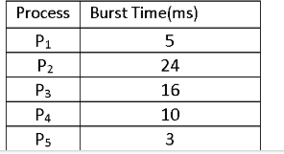
FCFS contd.
Now we calculate the
average waiting time,
average turnaround time and
throughput

Slide 13
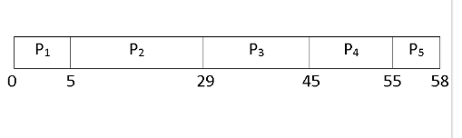
Average Waiting Time
Waiting Time = Starting Time - Arrival Time
Waiting time of
  P1 = 0
    P2 = 5 - 0 = 5 ms
    P3 = 29 - 0 = 29 ms
    P4 = 45 - 0 = 45 ms
    P5 = 55 - 0 = 55 ms
Average waiting time = (0 + 5 + 29 + 45 + 55) / 5 = 25 ms
Average Turnaround Time
Turnaround Time = Waiting time in the ready queue + executing time + waiting time in waiting queue for I/O

Slide 14
Turnaround time –
    P1 = 0 + 5 + 0 = 5ms
    P2 = 5 + 24 + 0 = 29ms
    P3 = 29 + 16 + 0 = 45ms
    P4 = 45 + 10 + 0 = 55ms
    P5 = 55 + 3 + 0 = 58ms
Total Turnaround Time = (5 + 29 + 45 + 55 + 58)ms = 192ms
Average Turnaround Time = (Total Turnaround Time / Total Number of Process) = (192 / 5)ms = 38.4ms
Throughput
Here, we have a total of five processes. Process P1, P2, P3, P4, and P5 takes 5ms, 24ms, 16ms, 10ms, and 3ms to execute respectively.
Throughput = (5 + 24 +16 + 10 +3) / 5 = 11.6ms
It means one process executes in every 11.6 ms.

Slide 15
2. Shortest-Job-First (SJF) Scheduling and SRTF

Slide 16
2. Shortest-Job-First (SJF) Scheduling
Associate with each process the length of its next CPU burst
  Use these lengths to schedule the process with the shortest time
SJF is optimal – gives minimum average waiting time for a given set of processes
  The difficulty is knowing the length of the next CPU request
  Could ask the user
Two schemes:
  Non-preemptive – once CPU given to the process it cannot be preempted until completes its CPU burst
  Preemptive – if a new process arrives with CPU burst length less than remaining time of current executing process, then preempt; know as the Shortest-Remaining- Time-First (SRTF)

Slide 17

Example of SJF
ProcessArriv l TimeBurst Time
P₁ 0.0 6
P₂ 2.0 8
P₃ 4.0 7
P₄ 5.0 3
SJF scheduling chart
Average waiting time = (3 + 16 + 9 + 0) / 4 = 7

Slide 18
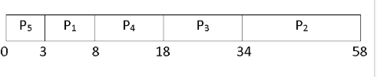
Average Waiting Time
Here arrival time is common to all processes(i.e., zero).
Waiting Time for
  P1 = 3 - 0 = 3ms
  P2 = 34 - 0 = 34ms
  P3 = 18 - 0 = 18ms
  P4 = 8 - 0 = 8ms
  P5 = 0ms
Now, Average Waiting Time = (3 + 34 + 18 + 8 + 0) / 5 = 12.6ms
Average Turnaround Time
  P1 = 3 + 5 = 8ms
  P2 = 34 + 24 = 58ms
  P3 = 18 + 16 = 34ms
  P4 = 8 + 10 = 18ms
  P5 = 0 + 3 = 3ms
Therefore, Average Turnaround Time = (8 + 58 + 34 + 18 + 3) / 5 = 24.2ms
Throughput
Here, we have a total of five processes. Process P1, P2, P3, P4, and P5 takes 5ms, 24ms, 16ms, 10ms, and 3ms to execute respectively.
Therefore, Throughput will be same as above problem i.e., 11.6ms for each process.

Slide 19
Example of Non-Preemptive SJF
Process Arrival Time Burst Time (ms)
P₁ P₂ P₃ P₄
0.0
2.0
4.0
5.0
7
4
1
4
SJF (non-preemptive)
P₁ |  |  |  |  |  |  | P₃ | P₂ |  |  |  | P₄
0 3 7 8 12
Average waiting time = (0 + 6 + 3 + 7)/4 = 4
16

Slide 20
Example of Preemptive SJF
Process | Arrival Time | Burst Time
P₁ | 0.0 | 7
P₂ | 2.0 | 4
P₃ | 4.0 | 1
P₄ | 5.0 | 4
SJF (Preemptive)
P₁ |  | P₂ |  | P₃ | P₂ |  | P₄ |  |  |  | P₁
0
2 4 5 7
11
16
Average waiting time = (9 + 1 + 0 +2)/4 = 3
Average Turnaround time=?

Slide 21
3. Shortest-Remaining-Time-First

Slide 22

3. Shortest-remaining-time-first
Now we add the concepts of varying arrival times and preemption to the analysis
Process Arrival Time Burst Time
P₁ 0 8
P₂ 1 4
P₃ 2 9
P₄ 3 5
Preemptive SJF Gantt Chart
Average waiting time = [(10-1)+(1-1)+(17-2)+5-3)]/4 = 26/4 = 6.5 msec
Average Turnaround time=?

Slide 23
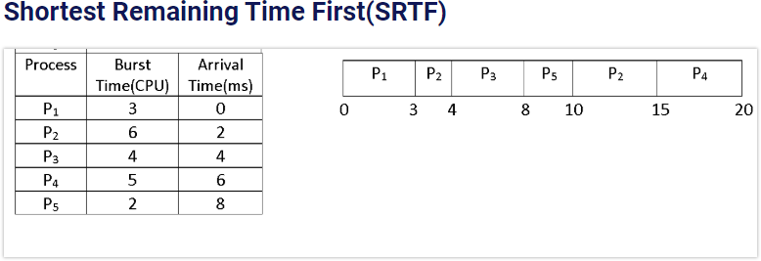
SRTF- Assignment

Slide 24
4. Priority Scheduling( PS)

Slide 25
4. Priority Scheduling
A priority number (integer) is associated with each process
The CPU is allocated to the process with the highest priority (smallest integer ≡ highest priority)
  Preemptive- preempt CPU if priority of newly arrived process is higher than priority of currently running process
  Nonpreemptive - put the new highest priority process at the head of the ready queue
SJF is priority scheduling where priority is the inverse of predicted next CPU burst time (largest CPU burst → lowest priority)
Problem ≡ Starvation – low priority processes is indefinitely blocked and may never execute
Solution ≡ Aging – as time progresses increase the priority of the process

Slide 26

Example of Priority Scheduling
ProcessA arri Burst TimeT Priority
P₁ 10 3
P₂ 1 1
P₃ 2 4
P₄ 1 5
P₅ 5 2
Priority scheduling Gantt Chart
Average waiting time = 8.2 msec

Slide 27
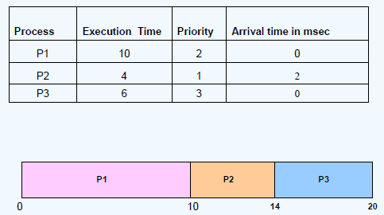
Priority Scheduling
(Non-Preemptive method)

Slide 28
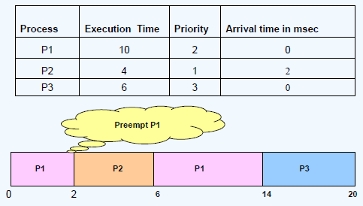
Priority Scheduling
(Preemptive method)

Slide 29
5. Round Robin (RR)
Each process gets a small unit of CPU time (time quantum q),
  usually 10-100 milliseconds.
  After this time has elapsed, the process is preempted and added to the end of the ready queue
If there are n processes in the ready queue and the time quantum is q, then each process gets 1/n of the CPU time in chunks of at most q time units at once.
  No process waits more than (n-1)q time units.
Timer interrupts every quantum to schedule next process
Performance
  q large ⇒ FIFO
  q small ⇒ q must be large with respect to context switch, otherwise overhead is too high

Slide 30

Example1 Time Quantum = 4
Process Burst Time
P₁ 24
P₂ 3
P₃ 3
The Gantt chart is:
Typically, higher average turnaround than SJF, but better response
q should be large compared to context switch time
q usually 10ms to 100ms, context switch < 10 usec

Slide 31
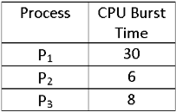
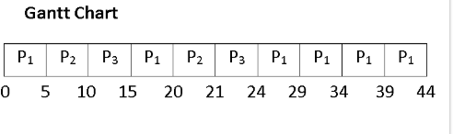
Example 2
time quantum: 5ms

Slide 32
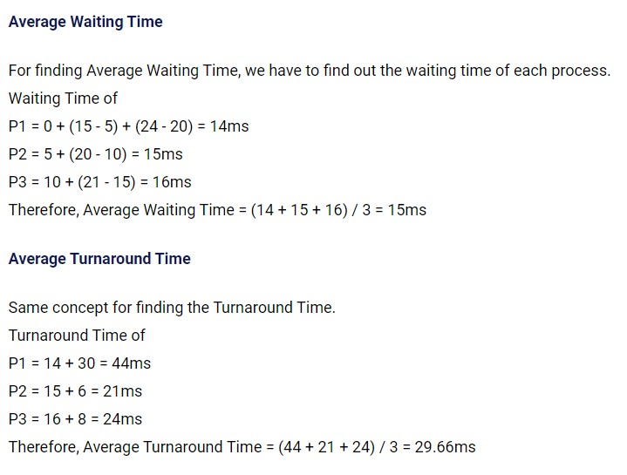

Slide 33
Example 3
Each process is given CPU time in turn, (i.e. time quantum: usually 10-100 milliseconds), and thus waits no longer than ( n – 1 ) * time quantum
time quantum = 20
Process | Burst Time | Wait Time
P₁ | 53 | 57 +24 = 81
P₂ | 17 | 20
P₃ | 68 | 37 + 40 + 17= 94
P₄ | 24 | 57 + 40 = 97
P₁ | P₂ | P₃ | P₄ | P₁ | P₃ | P₄ | P₁ | P₃ | P₃
0 20 37 57 77 97 117 121 134 154 162
P₁(53)
P₂(17) 20
P₁(33)
₂₄P₁(13)
57
₄₀P₃(48)
P₃(28) P₃(8)
P (68)
37
17
3
P₄(24)
57
40
P₄(4)
71
Average wait time = (81+20+94+97)/4 = 73

Slide 34
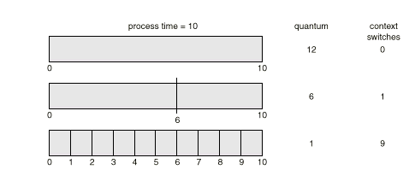
Round Robin Scheduling
Typically, higher average turnaround than SJF, but better response.
Performance
  q large ⇒ FCFS
  q small ⇒ q must be large with respect to context switch, otherwise
overhead is too high.

Slide 35
Example4 of RR with Time Quantum = 20
Process | Burst Time
P₁ | 53
P₂ | 17
P₃ | 68
P₄ | 24
The Gantt chart is:
0 20 37 57 77 97 117 121 134 154 162
Typically, higher average turnaround than SJF, but better
response
P₁ | P₂ | P₃ | P₄ | P₁ | P₃ | P₄ | P₁ | P₃ | P₃

Slide 36
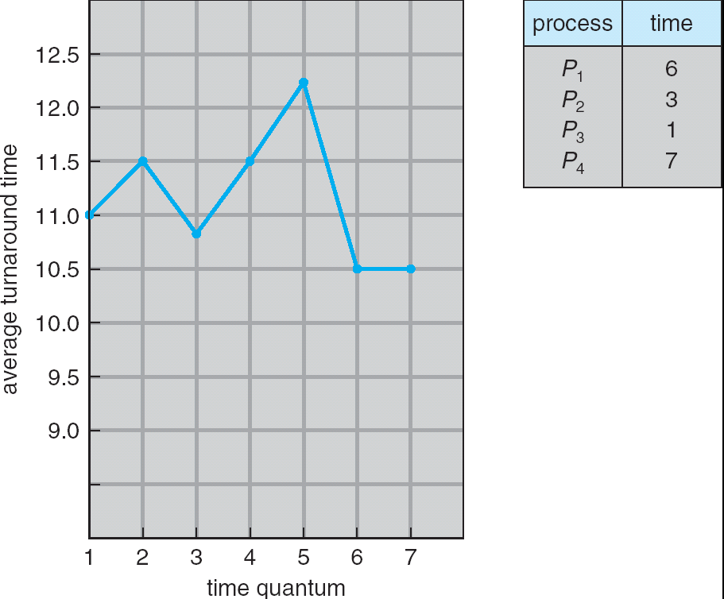
Turnaround Time Varies With The Time Quantum
Average turnaround time does not necessarily improve as size of q increases
Generally, average turnaround time can be improved if most processes finish
their CPU burst in a single time quantum
74

Slide 37
8. Multi-level Queue with and
without feed-back

Slide 38
Multilevel Queue
Ready queue is partitioned into separate queues, eg:
  foreground (interactive)
  background (batch)
Process permanently in a given queue
Each queue has its own scheduling algorithm:
  foreground – RR
  background – FCFS
Scheduling must be done between the queues:
  Fixed priority scheduling; (i.e., serve all from foreground then from background). Possibility of starvation.
  Time slice – each queue gets a certain amount of CPU time which it can schedule amongst its processes; i.e., 80% to foreground in RR
  20% to background in FCFS

Slide 39

Multilevel Queue Scheduling

Slide 40
Multilevel Feedback Queue
A process can move between the various queues; aging can be implemented this way
Multilevel-feedback-queue scheduler defined by the following parameters:
  number of queues
  scheduling algorithms for each queue
  method used to determine when to upgrade a process
  method used to determine when to demote a process
  method used to determine which queue a process will enter when that process needs service

Slide 41

Example of Multilevel Feedback Queue
Three queues:
  Q₀ – RR with time quantum 8 milliseconds
  Q₁ – RR time quantum 16 milliseconds
  Q₂ – FCFS
Scheduling
  A new job enters queue Q₀ which is served FCFS
    When it gains CPU, job receives 8 milliseconds
    If it does not finish in 8 milliseconds, job is moved to queue Q₁
  At Q₁ job is again served FCFS and receives 16 additional milliseconds
    If it still does not complete, it is preempted and moved to queue Q₂

